Slide 1

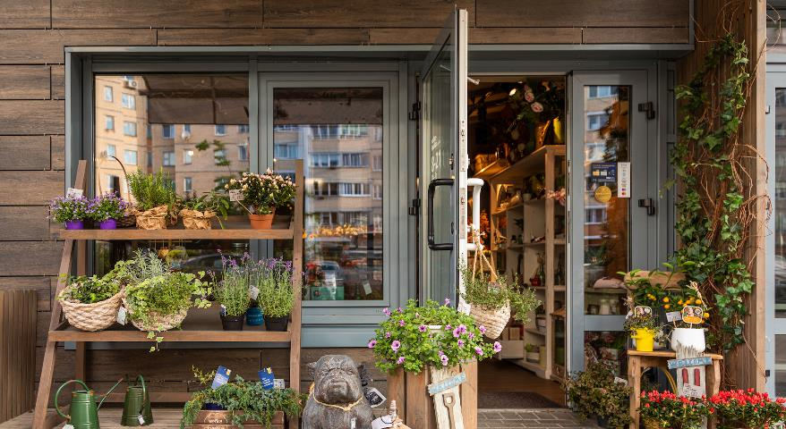
Advetisement Campaign
Goals – Results – Next Steps

Slide 2


Campaign Summary
Objective and Goals
Campaign Settings
Creativity and Tactics

Slide 3

Company and Campaign Goals
Objective and Goals
Campaign Settings
Creativity and Tactics
Objective
Sales: +10%
Goal
WS Visitors: ++10%
KPI
Clicksthoughs: +++
Time
42 Days
Calla & Ivi wanted to increase its sales by 10% by the end of the first quarter of the year.
The marketing team decided to launch a traffic campaign to their website to achieve this goal, in search of more customers.
The measurement of this goal in traffic was carried out through the clicks of the advertisements to the website during 42 days.
42

Slide 4

Campaign Settings
Objective and Goals
Campaign Settings
Creativity and Tactics
Objective : Traffic – Web Site Visitors
Audience : Woman. Age: 24-55. Interest: Cut Flowers. Northern Holland región.
Placement: Facebook, Instagram, Audience Network.
Duration: 42 days. I asume USD 2070/USD 50 > 41. Based on Free Sheeping Promo.
Budget: USD USD 50/Daily for each Promo.
Budget Optimization: Lower Cost.

Slide 5
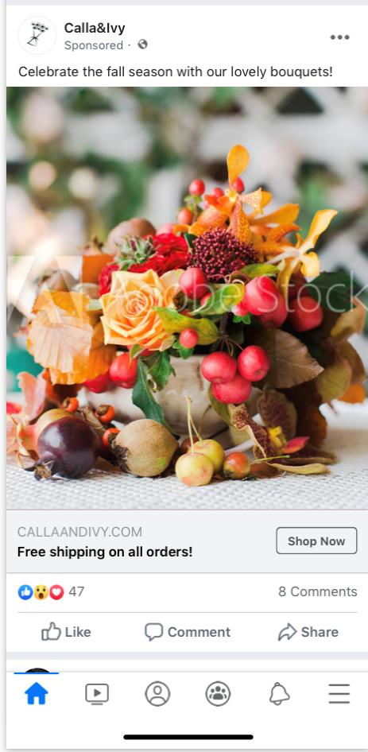
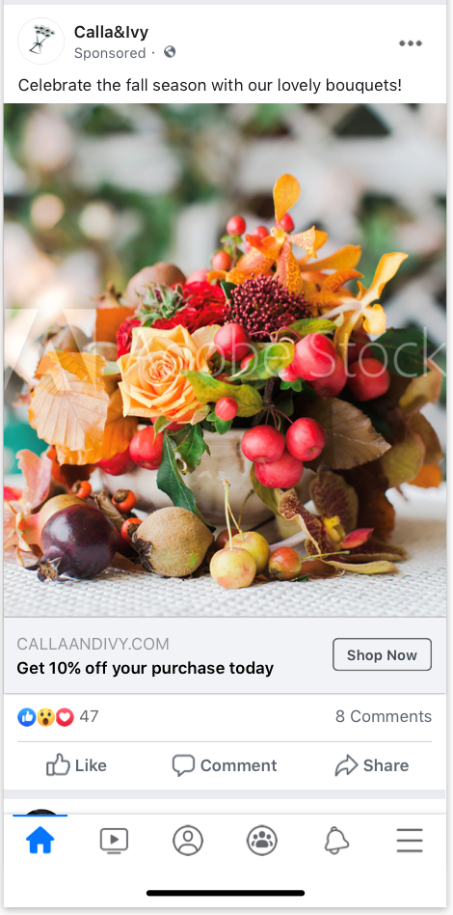
Creativity and Tactics
Objective and Goals
Campaign Settings
Creativity and Tactics
The team wanted to know what would produce more clicks between 10% discount and free shipping.
They decided on 2 promotions:
offering free shipping.
offering 10% discount.
Include an A / B test to evaluate which ad would best to help them achieve their campaign goal.
They aimed preferably at people buying bouquets.

Slide 6

Campaign Results
A/B Testing Analisys
Traffic Results
Return Analisys
Results Summary
Next Steps

Slide 7
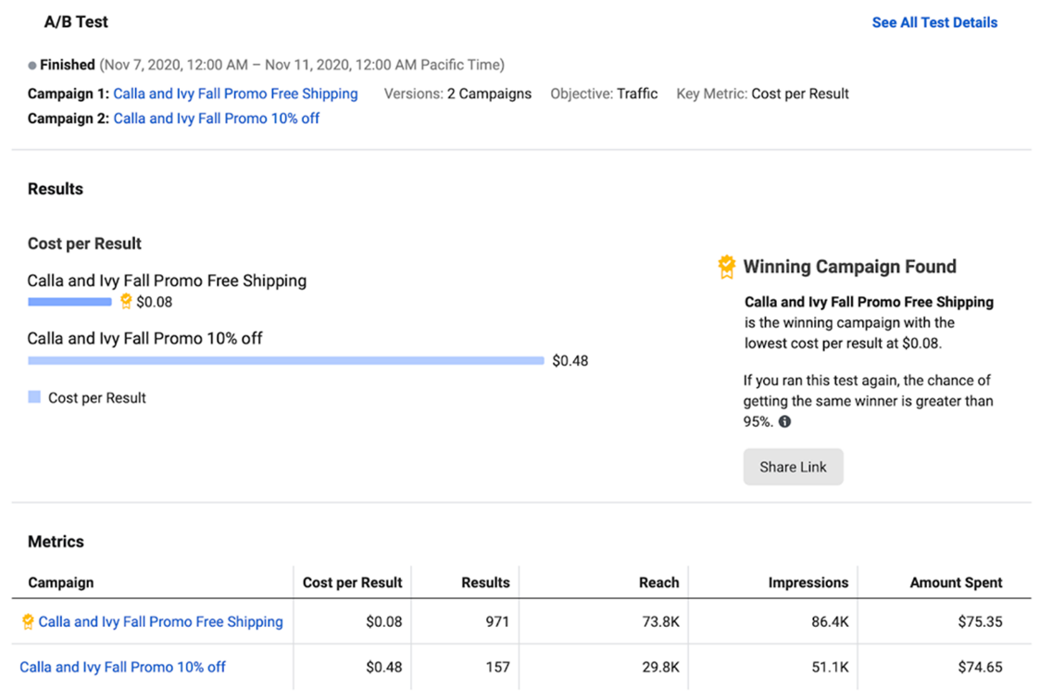
A/B Testing Analisys
A/B Testing Analisys
Traffic Results
Return Analisys
Summary
Next Steps
The winner of A/B Testing is Free Shipping Promo
This produces a notable improvement in costs for results of $ 0.08 vs. $ 0.48.
Increase reach and impressions and with it visits to the site.
Increase the probability of conversions, which is the goal of the campaign.
It is a much more efficient option than the alternative.

Slide 8
Traffic Results
A/B Testing Analisys
Traffic Results
Return Analisys
Summary
Next Steps
Link Clicks
10% Off
Promos Campaign
Impressions and Reach
Free Shipping
CTR (%)
1.2%
0.1%
1.4%
Reach / Impressions
71%
CPR ($)
0.07
0.48
0.05
(*)
Spent ($)
2,824
2,070
753
(*) In thousands of impressions and reach. CTR: Clicks Through. CPR: Cost Per Result. Spent: Amount Spent.

Slide 9
Return Analisys
A/B Testing Analisys
Traffic Results
Return Analisys
Summary
Next Steps
Indicators
Magin
% Convert: Conversion Rate
APV: Average Purchase Value.
ACP: Average Cost per Purchase.
Adv. Costs.: Advertisement Costs.
Purchase Costs: Sales Costs
ROAS: Return on Advertisement.
Inv. Costs: Adv. Costs + Sales Costs.
ROI: Return on Investment.
%
100%
38%
62%

Slide 10

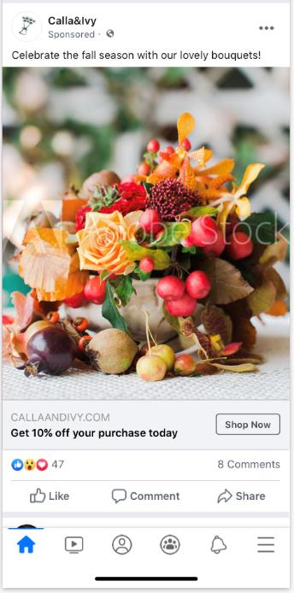
Results Summary
A/B Testing Analisys
Traffic Results
Return Analisys
Summary
Next Steps
The campaign has been successful
It helps to increase sales by increasing visits to the site.
The Free Sheeping promo is much more attractive than the 10% discount promo.
This gives an idea of comfort and ease of purchase.
Efficient Costs
Almost 90% of the scope is given by the Free Sheeping option
This produces a natural optimization of advertisement costs.
Optimize Return on Investment
It has a high ROAS and ROI
The advertisement costs are very low compared to the selling costs
The gross margin is not significantly impacted by the campaign and is greater than 60%.

Slide 11

Next Steps
A/B Testing Analisys
Traffic Results
Return Analisys
Summary
Next Steps
Carry out a new campaign taking advantage of the learning of the one analyzed in this presentation.
Use creativity and tone of messages similar to the current ones although renewed.
Emphasize the concept of free sheeping.
Dismiss the 10% discount promotion.
Find alternative promotions to analyze.
Maintain the same geographic target strategy
Search for similar geographic locations in terms of possible demand, remoteness, and delivery costs.
Evaluate results in one month.

Slide 12

Thank You!

